Slide 1

Data Communication and Computer Networks
11. Computer Networks Security
Dr. Aiman Hanna
Department of Computer Science & Software Engineering Concordia University, Montreal, Canada
These slides has mainly been extracted, modified and updated from original slides of : Computer Networking: A Top Down Approach, 6th edition Jim Kurose, Keith Ross Addison-Wesley, 2013
Additional materials have been extracted, modified and updated from: Understanding Communications and Networking, 3e by William A. Shay 2005
Copyright © 1996-2013 J.F Kurose and K.W. Ross
Copyright © 2005 William A. Shay
Copyright © 2018 Aiman Hanna All rights reserved

Slide 2
What is network security?
confidentiality: only sender, intended receiver should “understand” message contents
sender encrypts message
receiver decrypts message
authentication: sender, receiver want to confirm identity of each other
message integrity: sender, receiver want to ensure message not altered (in transit, or afterwards) without detection
access and availability: services must be accessible and available to users
Network Security

Slide 3



Friends and enemies: Alice, Bob, Trudy
well-known in network security world
Bob, Alice (friends) want to communicate “securely”
Trudy (intruder) may intercept, delete, add messages
Alice
Bob
channel
data, control messages
data
secure
sender
secure
receiver
data
Trudy

Slide 4
Who might Bob, Alice be?
… well, real-life Bobs and Alices!
Web browser/server for electronic transactions (e.g., on-line purchases)
on-line banking client/server
DNS servers
routers exchanging routing table updates
other examples?
Network Security

Slide 5
There are bad guys (and girls) out there!
Q: What can a “bad guy” do?
A: A lot!
eavesdrop: intercept messages
actively insert messages into connection
impersonation: can fake (spoof) source address in packet (or any field in packet)
hijacking: “take over” ongoing connection by removing sender or receiver, inserting himself in place
denial of service: prevent service from being used by others (e.g., by overloading resources)
….
Network Security

Slide 6
Network security
ideal scenario: prevent any unauthorized person from intercepting/viewing what is being transferred
however, this may not be possible
so, do not secure data; rather prevent unauthorized person from understanding them
encryption is used to achieve that

Slide 7
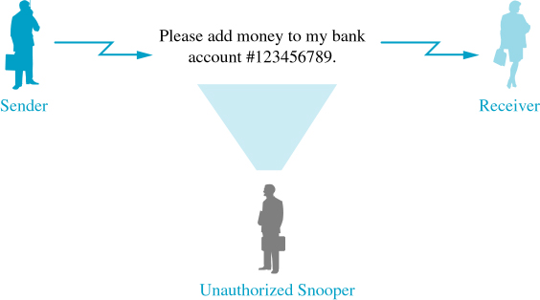
The language of cryptography
Privacy: prevent a third party from intercepting the information, and if intercepted from understanding it
encrypt the information, decryption is then necessary to understand it
Sending Unsecured Messages

Slide 8
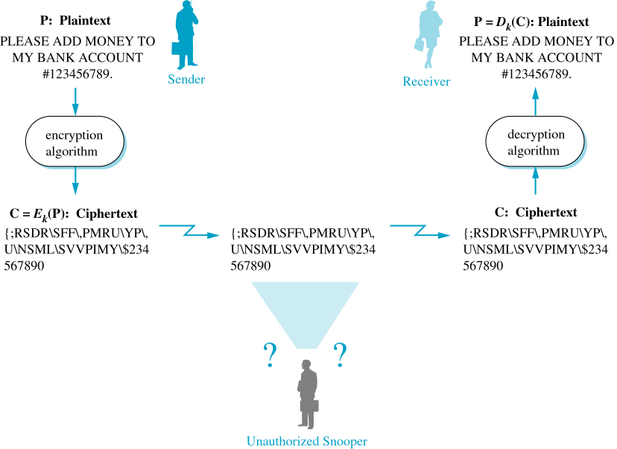
The language of cryptography
Plaintext: the message before encryption
Ciphertext: the encrypted message
Sending Encrypted Messages

Slide 9

The language of cryptography
Alice’s
encryption
key
Bob’s
decryption
key
K
K
A
B
plaintext
encryption
algorithm
ciphertext
decryption
algorithm
plaintext
m plaintext message
K_{A}(m) ciphertext, encrypted with key K_{A}
m = K_{B}(K_{A}(m))
Network Security

Slide 10
Breaking an encryption scheme!
encrypted data is decrypted if the encryption key and method are known
if the encryption and decryption keys are the same, this is called symmetric key cryptosystem
issues:
What happens if the key is compromised?
What happens if the key and encryption methods became known?
What about authentication & authorization?
Network Security

Slide 11
Breaking an encryption scheme!
cipher-text only attack: Trudy has ciphertext she can analyze
two approaches:
brute force: search through all keys
statistical analysis
known-plaintext attack: Trudy has plaintext corresponding to ciphertext
e.g., in monoalphabetic cipher, Trudy determines pairings for a,l,i,c,e,b,o,b
chosen-plaintext attack: Trudy can get ciphertext for chosen plaintext
Network Security

Slide 12
Symmetric key cryptography
K
K
S
S
plaintext
message, m
encryption
algorithm
ciphertext
decryption
algorithm
plaintext
K_{S}(m)
m = K_{S}(K_{S}(m))
symmetric key crypto: Bob and Alice share same (symmetric) key: K
e.g., key is knowing substitution pattern in mono alphabetic substitution cipher
Q: how do Bob and Alice agree on key value?
S
Network Security

Slide 13
Encryption schemes
Caesar Cipher
replaces each character by another
Example: What is the plaintext of the following ciphertext:
Yjq%mpqyu%yjgtg%vjg%tqcfu%yknn%ngcf%wu,%qpna%c%hqqn%yqwnf%uca
this is not so difficult to guess! Is it?
once some characters are guessed, the rest like the TV show Wheel of Fortune
Network Security

Slide 14
Encryption schemes
substitution cipher: substituting one thing for another
monoalphabetic cipher: substitute one letter for another
plaintext: abcdefghijklmnopqrstuvwxyz
ciphertext: mnbvcxzasdfghjklpoiuytrewq
e.g.:
Plaintext: bob. i love you. alice
ciphertext: nkn. s gktc wky. mgsbc
Encryption key: mapping from set of 26 letters
to set of 26 letters
Network Security

Slide 15
Encryption schemes
Polyalphabetic Cipher
plaintext characters are not always replaced with the same ciphertext character
for example, replace each character depending on character sequence as well as its position in the message
for (int i=0; i < length of P; i++)
C[i] = P[i] + K + (i mod 3)
If K=10, then 10 is added to characters in position 0, 3, 6, …; and 11 is added for those in positions 1, 4, 7; and 12 is added for those in 2, 5, 8
Network Security

Slide 16
Encryption schemes
Polyalphabetic Cipher
Example: THEMTHENTHEY will be UJHNVKFPWIG
THE is encrypted into UJH, VKF, and WIG
repetition is fewer but still there
a professional thief may still be able to break-in
Network Security

Slide 17
A more sophisticated encryption approaches
Transposition Cipher
rearrange the plaintext characters into a 2-D array and sends columns based on a specific permutation
problem: character frequencies are preserved
Example: FOLLOW THE YELLOW BRICK ROAD
if p₁=2, p₂=4, p₃=3, p₄=1, p_{m}=5 then the encrypted msg is:
O YWCALHLB LTE KDFW OIOOELRR
COLUMNS
1 2 3 4 5
F O L L O
W T H E
Y E L L
O W B R
I C K R
O A D
Network Security

Slide 18
A more sophisticated encryption approaches
n substitution ciphers, M₁,M₂,…,M_{n}
cycling pattern:
e.g., n=4: M₁,M₃,M₄,M₃,M₂; M₁,M₃,M₄,M₃,M₂; ..
for each new plaintext symbol, use subsequent substitution pattern in cyclic pattern
dog: d from M₁, o from M₃, g from M₄
Encryption key: n substitution ciphers, and cyclic pattern
key need not be just n-bit pattern
Network Security

Slide 19
A more sophisticated encryption approaches
Bit-Level Ciphering
not all transmissions are over characters
creates a key (a bit string) secretly and randomly
divides the message into substrings of the same length as the key
XOR all substrings with the key and transmit the result
decryption in that case is not a reverse operation; rather a repetition of the encryption operation
Network Security

Slide 20
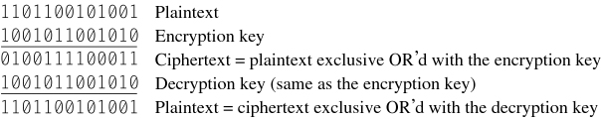
A more sophisticated encryption approaches
Bit-Level Ciphering
Example:
Encryption Using XOR Bit Operation
key length is sensitive here. Why?
Network Security

Slide 21
A more sophisticated encryption approaches
Bit-Level Ciphering
advantages:
key is used once, so comparisons to other cipher texts is not possible, so code is unbreakable without trying all possible decryption keys
such unbreakable ciphers are also called one-time pads
disadvantages:
keys, sometimes large ones, must be communicated to the receiver
keys are used only once!
Network Security

Slide 22
Symmetric key crypto: DES
Data Encryption Standards (DES)
widely used as encryption standard (US encryption standard [NIST 1993])
divides messages into 64-bit blocks and encrypts each one (using 56-bit symmetric key)
8 bits are used for error detection, so the key used is 56-bit
employs complex steps including transposition, XOR, substitutions, and others
in general, DES has a total of 19 steps, where the output of each step is the input of the following one
Network Security

Slide 23
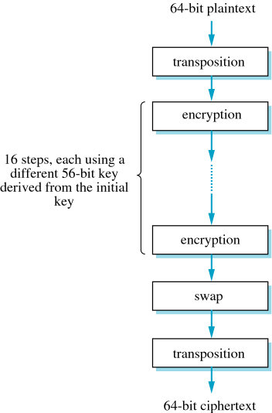
Symmetric key crypto: DES
DES: Data Encryption Standard
Outline of DES
Network Security

Slide 24
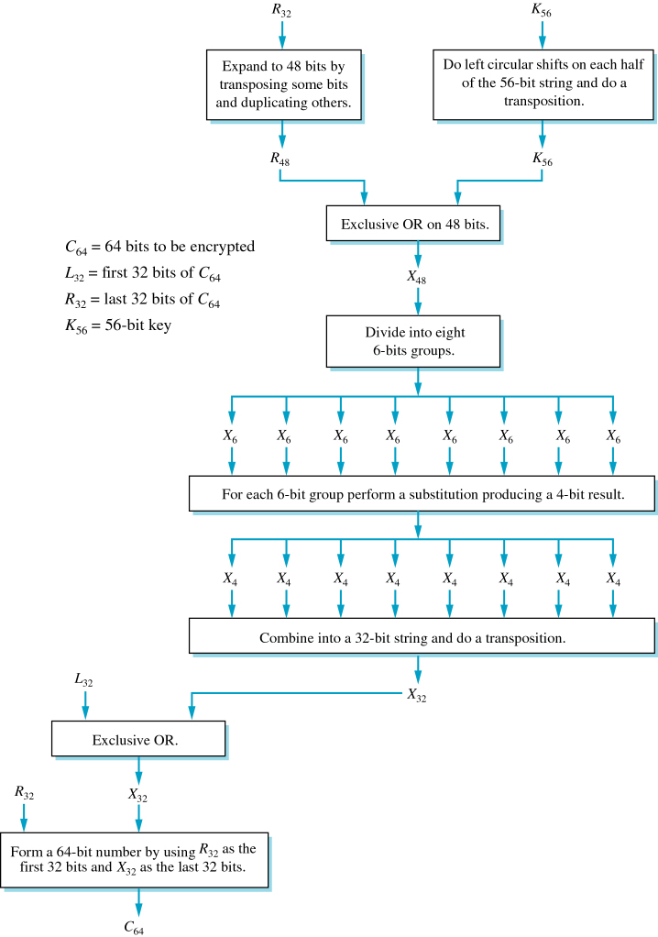
Symmetric key crypto: DES
DES: Data Encryption Standard
One of the 16 Steps of DES

Slide 25
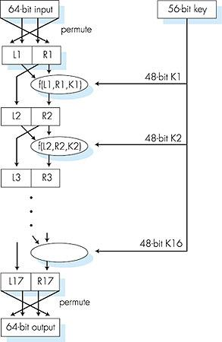
Symmetric key crypto: DES
DES operation
initial permutation
16 identical “rounds” of function application, each using different 48 bits of key
final permutation
Network Security

Slide 26
Symmetric key crypto: DES
Data Encryption Standards (DES)
DES can operate in several modes including:
ECB – Electronic Codebook
CBC – Cipher Block Chaining
with ECB, if the original string has similar 64-bit blocks, then the cipher of these blocks is consequently the same
this is not good since patterns are possible
CBC disrupts this pattern by performing an XOR between the block and the previous encrypted block before encrypting the new block
the 1st XOR is performed with an initialization vector
Network Security

Slide 27
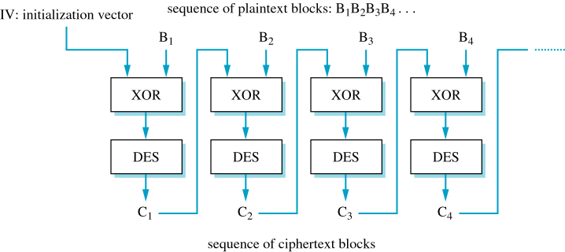
Symmetric key crypto: DES
Data Encryption Standards (DES) – CBC Mode
Cipher Block Chaining (CBC) Mode of DES Encryption
Network Security

Slide 28
Symmetric key crypto: DES
How secure is DES?
unless the key is knows it is very difficult to break
Brute Force attack is a method where all possible keys are attempted
56-bit key ➔ 2⁵⁶ ≈ 7.2 x 10¹⁶ possible keys
brute force these keys would take 4500 years in an Alpha station
for many years, researchers tried to break DES without success
in 1998, the Electronic Frontier Foundation built a DES Cracker, a specially designed computer, at a trivial cost of 250,000$
http://w2.eff.org/Privacy/Crypto/Crypto_misc/DESCracker/HTML/19980716_eff_des_faq.html#cost
that event rendered DES obsolete!
a key of 128 bits could provide a reasonable solution
2¹²⁸ ≈ 3 x 10³⁸ possible keys
A system that tries 1 billion keys / microsecond would still take about 9.5 x 10¹⁵ years to resolve all keys
Network Security

Slide 29
Triple DES
provides an alternative to DES
encrypts data 3 times
for example, suppose E_{K}(M) and D_{K}(M) are DES encryption and decryption using a key K, triple DES is calculated as
E_{K3}(D_{K2}(E_{K1}(M)))
Triple DES uses 168-bit key, and proved to be solid
relatively slow; 3 times of DES
Network Security

Slide 30
AES: Advanced Encryption Standard
another alternative to DES & Triple DES is the Advanced Encryption Standard (AES)
symmetric-key NIST standard, replaced DES (Nov 2001)
AES uses:
Rijndael algorithm, with
128, 192, or 256 bits key
brute force decryption (try each key) taking 1 sec on DES, takes 149 trillion years for AES! [NIST 2001]
Network Security

Slide 31
Key distribution and protection
all the major encryption methods depends on a secret key
if the key is compromised, the algorithm may hence become useless
how do sender and receiver exchange keys securely prior to the session?
Shamir’s method
Diffie-Hellman key exchange
Network Security

Slide 32
Key distribution and protection
Shamir’s method
can be used if the information is so sensitive that no single person can be trusted to keep, send or receive it
in such case, instead of keeping the key at one location, break it into different pieces
Shamir’s method does not actually break the key itself; rather
uses polynomial p(x)= a₀+a₁x+a₂x²+…+a_{k-1}x^{k-1}
each person is given a unique point (part of this polynomial)
P(x) can be calculated by communicating only those unique points
one of the coefficients ‘a_{i}’ is the key
Network Security

Slide 33
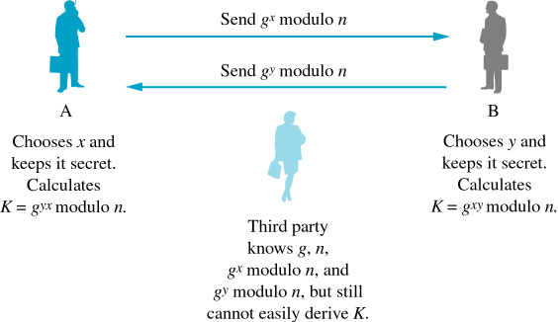
Diffie-Hellman key exchange
sender chooses a value x and keeps it secret; receiver chooses a value y and keeps it secret
the sender and receiver can then calculate the key
Diffie-Hellman Key Exchange
Network Security

Slide 34
Diffie-Hellman key exchange
Disadvantages:
both n and g must be very large (perhaps a thousand bits), in order to make it difficult to determine the key
susceptible to the Man-in-the-middle attack
an intruder may intercept g^{x} modulo n from A and forward it to B as g^{x’} modulo n
the intruder then intercepts g^{y} modulo n from B and forward it to A as g^{y’} modulo n
as far as A and B are concerned, all is fine. The intruder then uses
g^{xy’} modulo n to communicate with A and g^{yx’} modulo n to communicate with B
both A and B believe that they are communicating with each other while in reality, each of them is communicating with the intruder which decrypt the messages, then re-encrypting them and send them to the other side
Network Security

Slide 35

Public key cryptography
symmetric key crypto
requires sender, receiver know shared secret key
Q: how to agree on key in first place (particularly if never “met”)?
public key crypto
radically different approach [Diffie-Hellman76, RSA78]
sender, receiver do not share secret key
public encryption key known to all
private decryption key known only to receiver

Slide 36
Public key cryptography
reasonable assumption: If you know the encryption algorithm and the key then you can decrypt
a fact: In real life, not every reasonable thing holds true
the idea here is to have the encryption algorithm known, and have the key public (known to the entire world)!
yet, have only the receiver capable of decrypting the message
each receiver has some secret knowledge, for example a private key, that is necessary to decrypt the message
such systems are called Public Key Cryptosystems

Slide 37
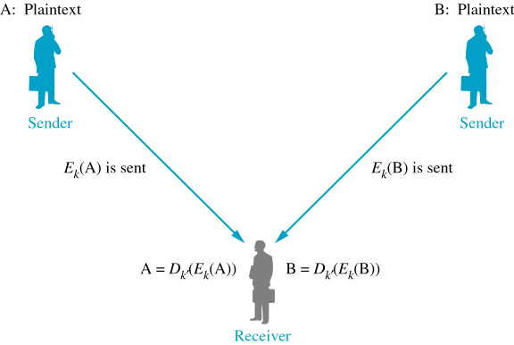
Public key cryptography
Multiple Senders Using The Same Encryption Method

Slide 38


Public key cryptography
assume the existence of an algorithm such that K_{a}(K_{b}(m)) = m for encryption/decryption keys K_{b} and K_{a}
instead of having Alice and Bob sharing the same key (as in symmetric key crypto), let them have two keys, where:
one the keys is a public key that is available to everyone in the world!
the other key is private to the receiver (i.e. Bob)
+
Bob’s public
key
K
B
-
Bob’s private
key
K
B
plaintext
message, m
encryption
algorithm
ciphertext
decryption
algorithm
plaintext
message
+
K (m)
-
+
B
m = K (K (m))
B
B
Network Security

Slide 39
Public key encryption algorithms
requirements:
.
.
+
-
1
need K ( ) and K ( ) such that
B
B
-
+
K (K (m)) = m
B
B
2
+
given public key K , it should be impossible to compute private key K
B
-
B
RSA: Rivest, Shamir, Adelson algorithm
Network Security

Slide 40
RSA algorithm
designed by Rivest, Shamir and Adleman
based on mathematical operations over very large numbers
ciphertext is surprisingly easy to calculate and very difficult to break even if the key is known
the idea here is to have the encryption algorithm known, and the key is known
Network Security

Slide 41
Prerequisite: modular arithmetic
x mod n = remainder of x when divide by n
facts:
[(a mod n) + (b mod n)] mod n = (a+b) mod n
[(a mod n) - (b mod n)] mod n = (a-b) mod n
[(a mod n) * (b mod n)] mod n = (a*b) mod n
thus
(a mod n)^{d} mod n = a^{d} mod n
example: x=14, n=10, d=2: (x mod n)^{d} mod n = 4² mod 10 = 6 x^{d} = 14² = 196 x^{d} mod 10 = 6
Network Security

Slide 42
RSA: getting ready
message: just a bit pattern
bit pattern can be uniquely represented by an integer number
thus, encrypting a message is equivalent to encrypting a number
example:
m = 10010001. This message is uniquely represented by the decimal number 145
to encrypt m, we encrypt the corresponding number, which gives a new number (the ciphertext)
Network Security

Slide 43
RSA algorithm
RSA Algorithm – Encryption
Illustrative example: Assume messages have only uppercase characters
1. Assign simple code to each character, for example, 1 to 26
2. Choose p & q prime numbers ➔ n = p * q
Both p & q are secrets and known to the receiver
For example n = 11 * 7
3. Find a number k that is relatively prime to (p -1) * (q -1), in this example 60
This k is the encryption key. In this example, k can be 7
4. Divide the message into components; each with many characters to avoid repetition. In this example however assume each component has one character.
For example, if the message is “HELLO” ➔ Component are H, E, L, L & O
5. Concatenate the binary codes of each character in a component and find the integer value of the result.
In our example, the integers of the components will be: 8, 5, 12, 12 & 15
Network Security

Slide 44
RSA algorithm
Illustrative example (Continues …)
6. Encrypt the message by raising each number to the power of k then modulo n.
in our example, that is:
8⁷ modulo 77; 5⁷ modulo 77; 12⁷ modulo 77; 12⁷ modulo 77; 15⁷ modulo 77
The results compose the encrypted message
in our example, the encrypted message 57, 47, 12, 12, 71
➔ Now when the receiver gets this encrypted message, how can it decrypt it?
Network Security

Slide 45
RSA algorithm
RSA Algorithm – Decryption
Illustrative example (Continues …)
How can the receiver decrypt the message?
1. Find a value k’ such that
[(k * k’) – 1] modulo [(p – 1) * (q – 1)] = 0
in other words, (k * k’) – 1 is evenly divisible by (p – 1) * (q – 1)
➔ The value of k’ is the decryption key
In our example, k’ can be 43 since (43 * 7) – 1 = 300 divides 60
2. Raise each number of the encrypted message by k’ then do modulo n
In our example, that will be:
57⁴³ modulo 77; 47⁴³ modulo 77; 12⁴³ modulo 77;
12⁴³ modulo 77; 71⁴³ modulo 77
➔ that results in 8, 5, 12, 12 and 15, which are the original numbers
Network Security

Slide 46
RSA: Summery
Creating public/private key pair
1. choose two large prime numbers p, q.
(e.g., 1024 bits each)
2. compute n = pq, z = (p-1)(q-1)
3. choose k (with k<n) that has no common factors
with z (k, z are “relatively prime”).
4. choose k’ such that k.k’-1 is exactly divisible by z.
(in other words: k.k’ mod z = 1 ).
5. public key is (n,k). private key is (n,k’).
+
-
K
K
B
B
Network Security

Slide 47
RSA: Summery
encryption, decryption
0. given (n,k) and (nk’) as computed above
1. to encrypt message m (<n), compute
k
c = m mod n
2. to decrypt received bit pattern, c, compute
K’
m = c mod n
magic
happens!
k
k’
m = (m mod n)
mod n
c
Network Security

Slide 48
RSA - example2:
Bob chooses p=5, q=7. Then n=35, z=24.
k=5 (so e, z relatively prime).
k’=29 (so k.k’-1 exactly divisible by z).
encrypting 8-bit messages.
m
k
k
bit pattern
m
c = m mod n
encrypt:
0000l000
12
24832
17
k’
K’
c
c
m = c mod n
decrypt:
17
481968572106750915091411825223071697
12
Network Security

Slide 49
Why does RSA work?
must show that c^{k’} mod n = m where c = m^{k} mod n
fact: for any x and y: x^{y} mod n = x^{(y mod z)} mod n
where n= pq and z = (p-1)(q-1)
thus, c^{k’} mod n = (m^{k} mod n)^{k’} mod n
= m^{k.k’} mod n
= m^{(k.k’} ^{mod z)} mod n
= m¹ mod n
= m
Network Security

Slide 50
How secure is RSA?
Encryption algorithm requires k & n
Decryption requires k’ & n
Interception of a message would reveal both k & n
So, the question is how easy can k’ be calculated/obtained?
K’ is chosen based on:
[(k * k’) – 1] modulo [(p – 1) * (q – 1)] = 0
If p & q are guessed then k’ is obtained
n = p * q, and n is known!
It does not look so difficult then; does it?
p & q are very big numbers that n is usually more than 200 digits
It is very difficult to guess (factor in fact) p & q from n
Factoring an RSA 2048-bit number has been worth 200,000$ prize (as of Sept 12, 2007)
Click here to see RSA Click here to see RSA Challeng Numbers
Network Security

Slide 51
RSA: another important property
The following property will be very useful later:
-
+
+
-
K (K (m)) = m
=
K (K (m))
B
B
B
B
use public key first, followed by private key
use private key first, followed by public key
result is the same!
Network Security

Slide 52
Why
-
+
+
-
K (K (m)) = m
?
=
K (K (m))
B
B
B
B
follows directly from modular arithmetic:
(m^{e} mod n)^{d} mod n = m^{ed} mod n
= m^{de} mod n
= (m^{d} mod n)^{e} mod n
Network Security

Slide 53
Authentication
Goal: Bob wants Alice to “prove” her identity to him
Protocol ap1.0: Alice says “I am Alice”
“I am Alice”
Failure scenario??
Network Security

Slide 54
Authentication
Goal: Bob wants Alice to “prove” her identity to him
Protocol ap1.0: Alice says “I am Alice”
in a network,
Bob can not “see” Alice, so Trudy simply declares
herself to be Alice
“I am Alice”
Network Security

Slide 55
Authentication: another try
Protocol ap2.0: Alice says “I am Alice” in an IP packet
containing her source IP address
Alice’s
IP address
“I am Alice”
Failure scenario??
Network Security

Slide 56
Authentication: another try
Protocol ap2.0: Alice says “I am Alice” in an IP packet
containing her source IP address
Trudy can create
a packet “spoofing”
Alice’s address
Alice’s
IP address
“I am Alice”
Network Security

Slide 57
Authentication: another try
Protocol ap3.0: Alice says “I am Alice” and sends her
secret password to “prove” it.
Alice’s
IP addr
Alice’s
password
“I’m Alice”
Failure scenario??
Alice’s
IP addr
OK
Network Security

Slide 58

Authentication: another try
Protocol ap3.0: Alice says “I am Alice” and sends her
secret password to “prove” it.
Alice’s
IP addr
Alice’s
password
“I’m Alice”
playback attack: Trudy records Alice’s packet
and later
plays it back to Bob
Alice’s
IP addr
OK
Alice’s
IP addr
Alice’s
password
“I’m Alice”
Network Security

Slide 59
Authentication: yet another try
Protocol ap3.1: Alice says “I am Alice” and sends her
encrypted secret password to “prove” it.
Alice’s
IP addr
encrypted
password
“I’m Alice”
Failure scenario??
Alice’s
IP addr
OK
Network Security

Slide 60
Authentication: yet another try
Protocol ap3.1: Alice says “I am Alice” and sends her
encrypted secret password to “prove” it.
Alice’s
IP addr
encrypted
password
“I’m Alice”
record
and
playback
still works!
Alice’s
IP addr
OK
Alice’s
IP addr
encrypted
password
“I’m Alice”
Network Security

Slide 61
Authentication: yet another try
Goal: avoid playback attack
nonce: number (R) used only once-in-a-lifetime
ap4.0: to prove Alice “live”, Bob sends Alice nonce, R. Alice
must return R, encrypted with shared (symmetric) secret key
“I am Alice”
R
K (R)
Alice is live, and only Alice knows key to encrypt nonce, so it must be Alice!
A-B
Failures, drawbacks?
Network Security

Slide 62
Authentication: ap5.0
ap4.0 requires shared symmetric key
can we authenticate using public key techniques?
ap5.0: use nonce, public key cryptography
“I am Alice”
Bob computes
R
+
-
-
K
(K (R)) = R
K (R)
A
A
A
and knows only Alice could have the private key, that encrypted R such that
“send me your public key”
+
K
A
+
-
K
(K (R)) = R
A
A
Network Security

Slide 63
ap5.0: security hole
man (or woman) in the middle attack (as seen in Diffie-Hellman): Trudy poses as Alice (to Bob) and as Bob (to Alice)
I am Alice
I am Alice
R
-
K (R)
T
R
-
Send me your public key
K (R)
+
A
K
T
Send me your public key
+
K
A
+
K (m)
Trudy gets
T
-
+
+
m = K (K (m))
K (m)
T
T
-
A
sends m to Alice encrypted with Alice’s public key
+
m = K (K (m))
A
A
Network Security

Slide 64
ap5.0: security hole
man (or woman) in the middle attack: Trudy poses as Alice (to Bob) and as Bob (to Alice)
difficult to detect:
Bob receives everything that Alice sends, and vice versa. (e.g., so Bob, Alice can meet one week later and recall conversation!)
problem is that Trudy receives all messages as well!
Network Security

Slide 65
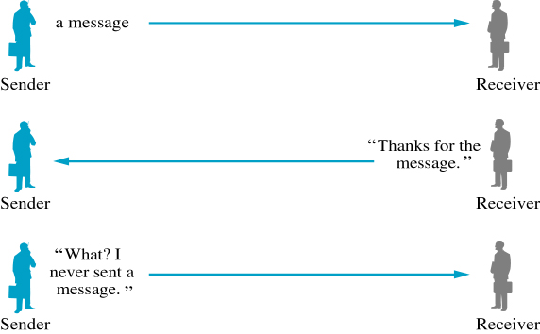
Digital signatures
used for authentication purposes
Sender Denying Sending a Message
Network Security

Slide 66
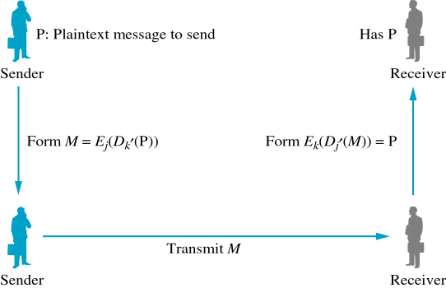
Digital signatures
the sender has an encryption key k’ and the receiver has a decryption key j’; both k’ and j’ are private keys while k & j are public keys
the sender is hence the only one that can sends an authenticated message
Sending a Message Using a Digital Signature
Network Security

Slide 67
Digital signatures
cryptographic technique analogous to hand-written signatures:
sender (Bob) digitally signs document, establishing he is document owner/creator.
verifiable, nonforgeable: recipient (Alice) can prove to someone that Bob, and no one else (including Alice), must have signed document
Network Security

Slide 68
Digital signatures
simple digital signature for message m:
Bob signs m by encrypting with his private key K_{B}, creating “signed” message, K_{B}(m)
-
-
Bob’s message, m
-
Bob’s private
key
-
K
m,K
(m)
B
B
Dear Alice
Oh, how I have missed you. I think of you all the time! …(blah blah blah)
Bob
Bob’s message, m, signed (encrypted) with his private key
Public key
encryption
algorithm
Network Security

Slide 69
Digital signatures
-
suppose Alice receives msg m, with signature: m, K_{B}(m)
Alice verifies m signed by Bob by applying Bob’s public key K_{B} to K_{B}(m) then checks K_{B}(K_{B}(m) ) = m.
If K_{B}(K_{B}(m) ) = m, whoever signed m must have used Bob’s private key.
+
-
+
-
+
-
Alice thus verifies that:
Bob signed m
no one else signed m
Bob signed m and not m‘
non-repudiation:
Alice can take m, and signature K_{B}(m) to court and prove that Bob signed m
-
Network Security

Slide 70
Message digests
large
message
m
H: Hash
Function
computationally expensive to public-key-encrypt long messages
goal: fixed-length, easy- to-compute digital “fingerprint”
apply hash function H to m, get fixed size message digest, H(m).
H(m)
Hash function properties:
many-to-1
produces fixed-size msg digest (fingerprint)
given two different messages x and y, it is computationally infeasible that H(x) = H(y)
Network Security

Slide 71
Digital signatures – Hash functions
the hash function used, also referred to as message digest
Fixed-length hash: H(m)
Bob’s long message, m
Dear Alice
Oh, how I have missed you. I think of you all the time! …
…
…
Bob
Many-to-one
hash function
ohjsgjh;jhaskmbhuhajhakjhajgeipiow
Network Security

Slide 72
Internet checksum: poor crypto hash function
Internet checksum has some properties of hash function:
produces fixed length digest (16-bit sum) of message
is many-to-one
But given message with given hash value, it is easy to find another message with same hash value:
message
ASCII format
message
ASCII format
I O U 1
0 0 . 9
9 B O B
49 4F 55 31
30 30 2E 39
39 42 D2 42
I O U 9
0 0 . 1
9 B O B
49 4F 55 39
30 30 2E 31
39 42 D2 42
B2 C1 D2 AC
different messages
but identical checksums!
B2 C1 D2 AC
Network Security

Slide 73
Hash function algorithms
major existing hash functions include:
MD5 hash function
widely used (RFC 1321)
computes 128-bit message digest in 4-step process.
arbitrary 128-bit string x, appears difficult to construct msg m whose MD5 hash is equal to x
SHA-1 - Secure Hash Algorithm
US standard [NIST, FIPS PUB 180-1]
160-bit message digest
the longer output length makes SHA-1 more secure
Network Security

Slide 74
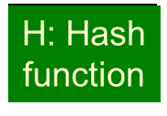

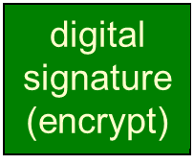
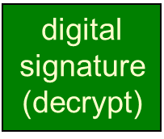
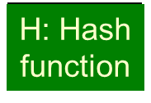
Digital signature = signed message digest
Bob sends digitally signed message:
Alice verifies signature, integrity of digitally signed message:
large
message
m
H(m)
encrypted
msg digest
-
K_{B}(H(m))
Bob’s
private
key
large
message
m
-
Bob’s
public
key
K
B
+
K
encrypted
msg digest
B
+
-
K_{B}(H(m))
H(m)
H(m)
equal
?
Network Security

Slide 75
Public-key certification
an important application to digital signature is public-key certification:
certifies that a public-key indeed belongs to a specific entity
motivation: Trudy plays pizza prank on Bob
Trudy creates e-mail order: Dear Pizza Store, Please deliver to me four pepperoni pizzas. Thank you, Bob
Trudy signs order with her private key
Trudy sends order to Pizza Store
Trudy sends to Pizza Store her public key, but says it’s Bob’s public key
Pizza Store verifies signature; then delivers four pepperoni pizzas to Bob
Bob doesn’t even like pepperoni!
Network Security

Slide 76
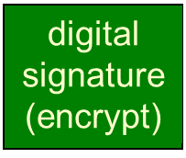


Certification authorities
certification authority (CA): binds public key to particular entity, E.
E (person, router) registers its public key with CA.
E provides “proof of identity” to CA.
CA creates certificate binding E to its public key.
certificate containing E’s public key digitally signed by CA – CA says “this is E’s public key”
the certificate itself is digitally signed by the CA
Bob’s
public
key
+
K
+
B
K
B
CA
private
key
certificate for Bob’s public key, signed by CA
-
Bob’s
identifying information
K
CA
Network Security

Slide 77

Certification authorities
when Alice wants Bob’s public key:
gets Bob’s certificate (Bob or elsewhere).
apply CA’s public key to Bob’s certificate, get Bob’s public key
+
Bob’s
public
key
K
B
+
K
B
CA
public
key
+
K
CA
Network Security

Slide 78


Firewalls
firewall
isolates organization’s internal net from larger Internet, allowing some packets to pass, blocking others
administered
network
public
Internet
trusted “good guys”
untrusted “bad guys”
firewall
Network Security

Slide 79
Firewalls: why
prevent denial of service attacks:
SYN flooding: attacker establishes many bogus TCP connections, no resources left for “real” connections
prevent illegal modification/access of internal data
e.g., attacker replaces CIA’s homepage with something else
allow only authorized traffic to inside network
set of authenticated users/hosts
three types of firewalls:
stateless packet filters
stateful packet filters
application gateways
Network Security

Slide 80
Stateless packet filtering
Should arriving packet be allowed in? Departing packet let out?
internal network connected to the ISP (and hence the Internet) via a gateway router (router firewall)
router filters packet-by-packet, decision to forward/drop packet based on:
source IP address, destination IP address
TCP/UDP source and destination port numbers
TCP flag bits: SYN, ACK, …
other rules for datagram leaving/entering
…
Network Security

Slide 81
Stateless packet filtering: example
example 1: block incoming and outgoing datagrams with IP protocol field = 17 and with either source or dest port = 23
result: all incoming, outgoing UDP flows and telnet connections are blocked
example 2: block inbound TCP segments with ACK=0.
result: prevents external clients from making TCP connections with internal clients, but allows internal clients to connect to outside.
Network Security

Slide 82
Stateless packet filtering: more examples
Policy | Firewall Setting
No outside Web access. | Drop all outgoing packets to any IP address, port 80
No incoming TCP connections, except those for institution’s public Web server only. | Drop all incoming TCP SYN packets to any IP except 130.207.244.203, port 80
Prevent Web-radios from eating up the available bandwidth. | Drop all incoming UDP packets - except DNS and router broadcasts.
Prevent your network from being used for a smurf DoS attack. | Drop all ICMP packets going to a “broadcast” address (e.g. 130.207.255.255).
Prevent your network from being tracerouted | Drop all outgoing ICMP TTL expired traffic
Network Security

Slide 83
Access Control Lists
ACL: table of rules, applied top to bottom to incoming packets: (action, condition) pairs
action | source address | dest address | protocol | source port | dest port | flag bit
allow | 222.22/16 | outside of 222.22/16 | TCP | > 1023 | 80 | any
allow | outside of 222.22/16 | 222.22/16 | TCP | 80 | > 1023 | ACK
allow | 222.22/16 | outside of 222.22/16 | UDP | > 1023 | 53 | ---
allow | outside of 222.22/16 | 222.22/16 | UDP | 53 | > 1023 | ----
deny | all | all | all | all | all | all
Network Security

Slide 84
Stateful packet filtering
stateless packet filter: heavy handed tool
admits packets that “make no sense,” e.g., dest port = 80, ACK bit set, even though no TCP connection established:
action | source address | dest address | protocol | source port | dest port | flag bit
allow | outside of 222.22/16 | 222.22/16 | TCP | 80 | > 1023 | ACK
stateful packet filter: track status of every TCP connection
track connection setup (SYN), teardown (FIN): determine whether incoming, outgoing packets “makes sense”
timeout inactive connections at firewall: no longer admit packets
Network Security

Slide 85
Stateful packet filtering
ACL augmented to indicate need to check connection state table before admitting packet
action | source address | dest address | proto | source port | dest port | flag bit | check conxion
allow | 222.22/16 | outside of 222.22/16 | TCP | > 1023 | 80 | any
allow | outside of 222.22/16 | 222.22/16 | TCP | 80 | > 1023 | ACK | x
allow | 222.22/16 | outside of 222.22/16 | UDP | > 1023 | 53 | ---
allow | outside of 222.22/16 | 222.22/16 | UDP | 53 | > 1023 | ---- | x
deny | all | all | all | all | all | all
Network Security

Slide 86


Application gateways
gateway-to-remote
host telnet session
host-to-gateway
telnet session
filters packets on application data as well as on IP/TCP/UDP fields.
example: allow select internal users to telnet outside.
application
gateway
router and filter
1. require all telnet users to telnet through gateway.
2. for authorized users, gateway sets up telnet connection to dest host. Gateway relays data between 2 connections
3. router filter blocks all telnet connections not originating from gateway.
Network Security

Slide 87
Limitations of firewalls, gateways
IP spoofing: router can’t know if data “really” comes from claimed source
if multiple app’s. need special treatment, each has own app. Gateway
client software must know how to contact gateway.
e.g., must set IP address of proxy in Web browser
filters often use all or nothing policy for UDP
tradeoff: degree of communication with outside world, level of security
many highly protected sites still suffer from attacks
Network Security

Slide 88
Intrusion detection systems
packet filtering:
operates on TCP/IP headers only
no correlation check among sessions
IDS: intrusion detection system
deep packet inspection: look at packet contents (e.g., check character strings in packet against database of known virus, attack strings)
examine correlation among multiple packets
port scanning, network mapping, DoS attack. …
IDS systems can broadly be classified as:
Signature-based systems
Anomaly-based systems
Network Security

Slide 89
Intrusion detection systems
multiple IDSs: different types of checking at different locations for performance reasons
allows filtering at a further downstream location, hence targeting only part of the traffic
firewall
internal
network
Internet
IDS
sensors
Web
server
DNS
server
FTP
server
demilitarized
zone
Network Security

